Slide 1
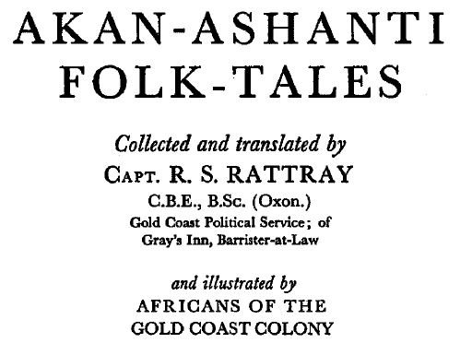
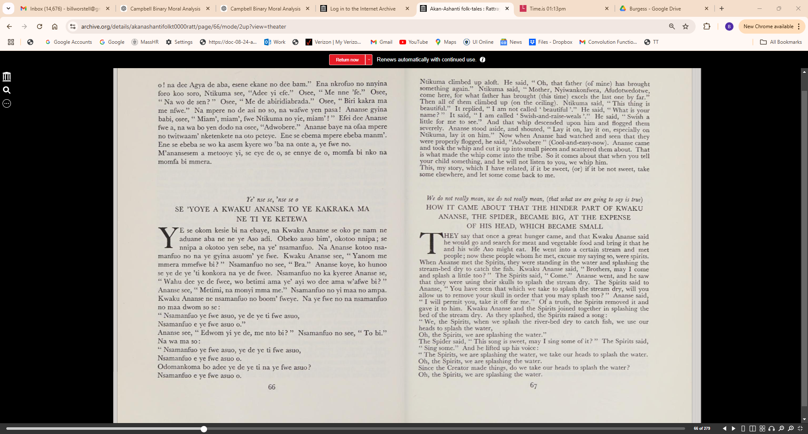

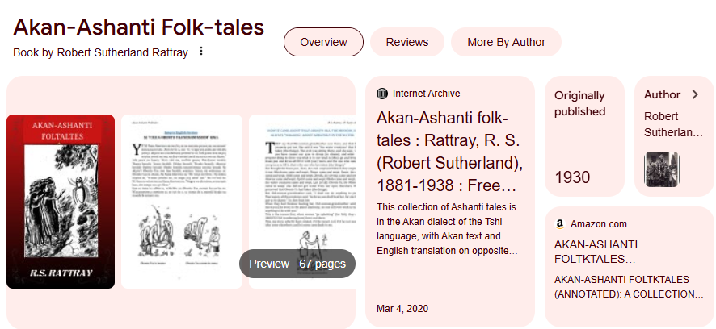
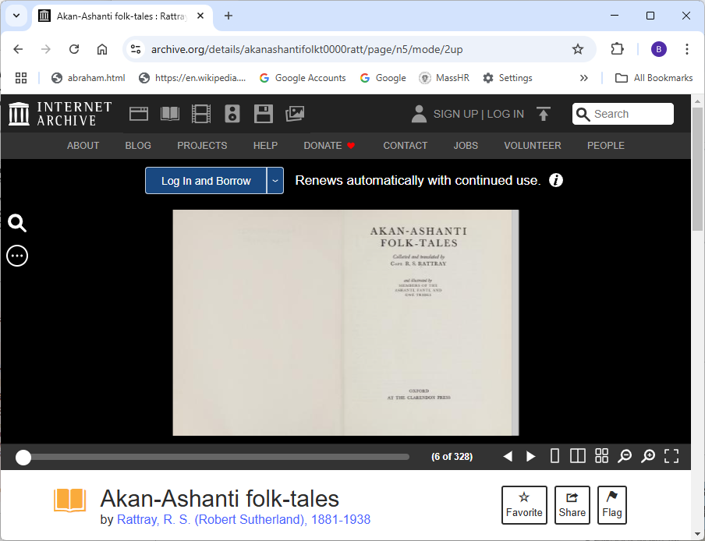
Demo Source Material:
https://archive.org/details/akanashantifolkt0000ratt/page/n5/mode/2up

Slide 2
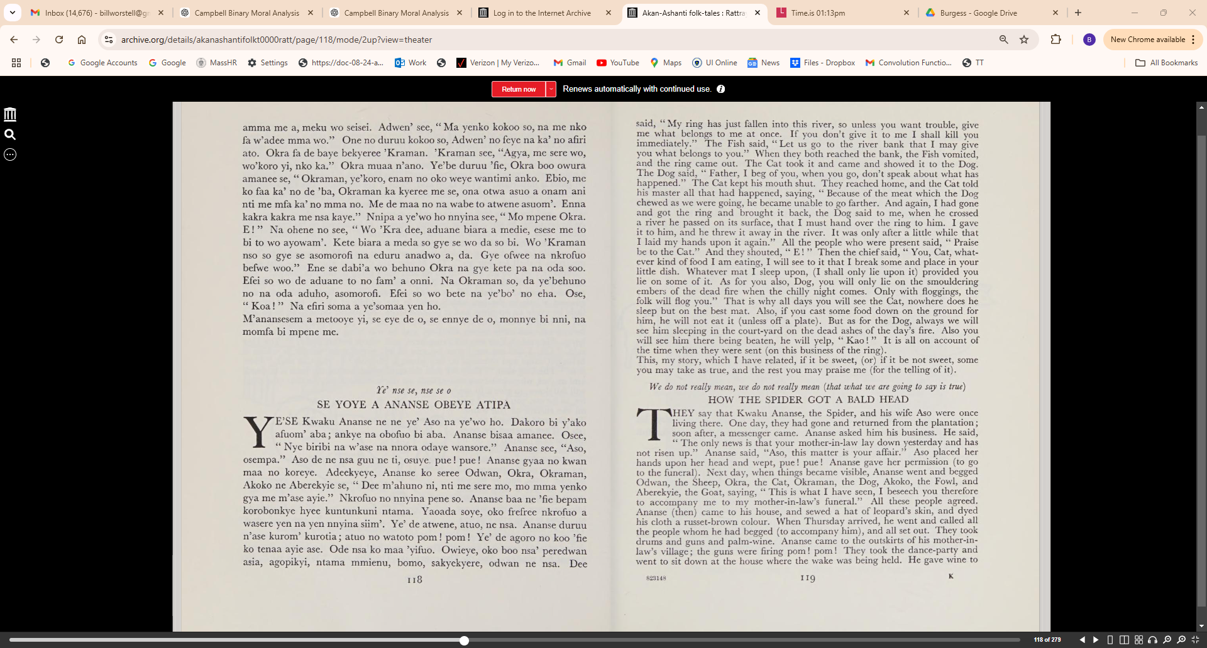

Slide 3
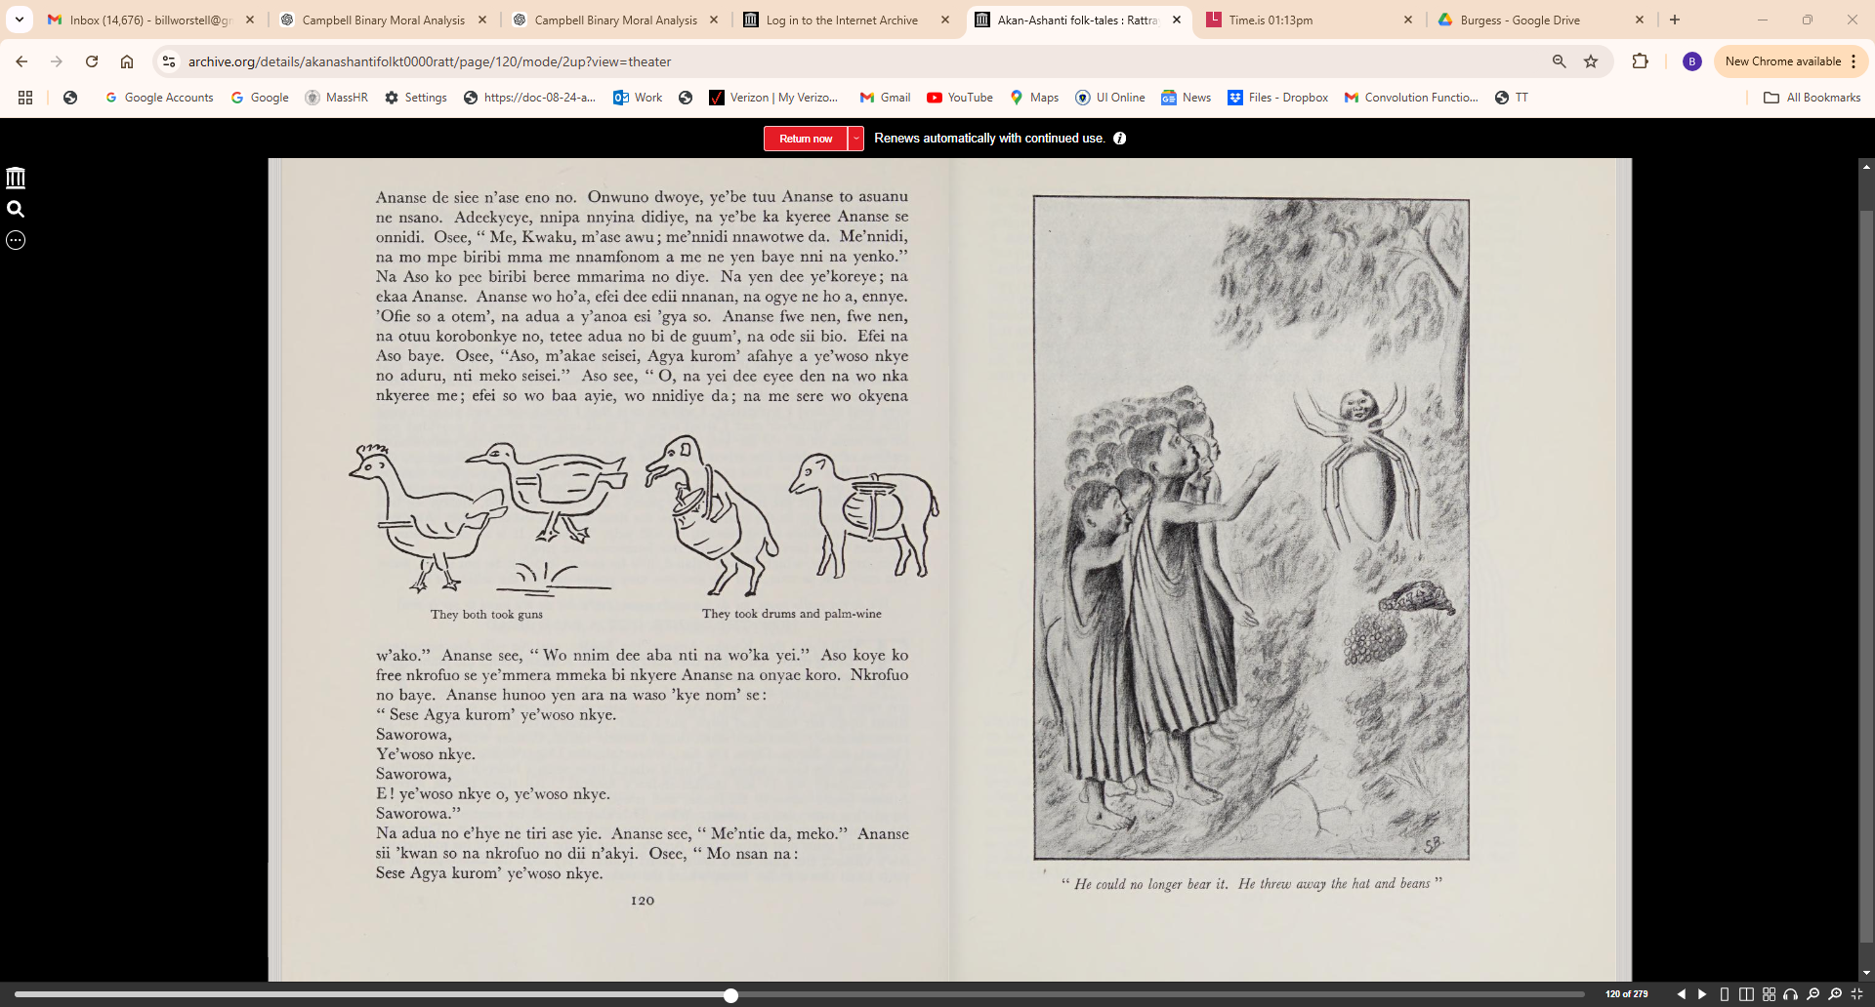

Slide 4
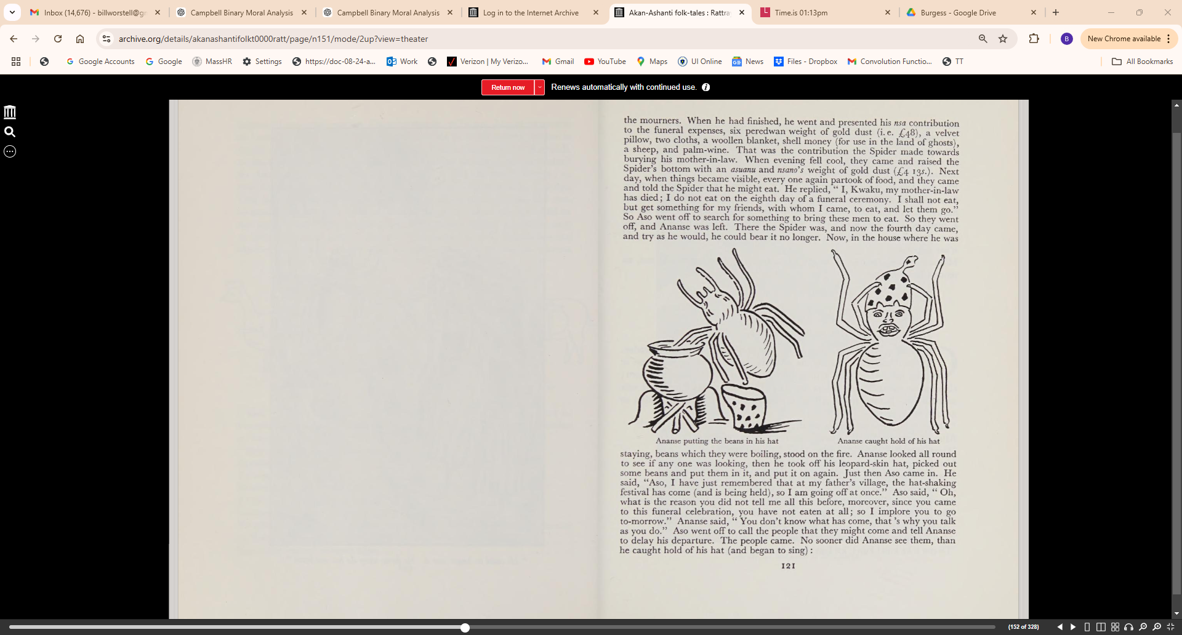

Slide 5
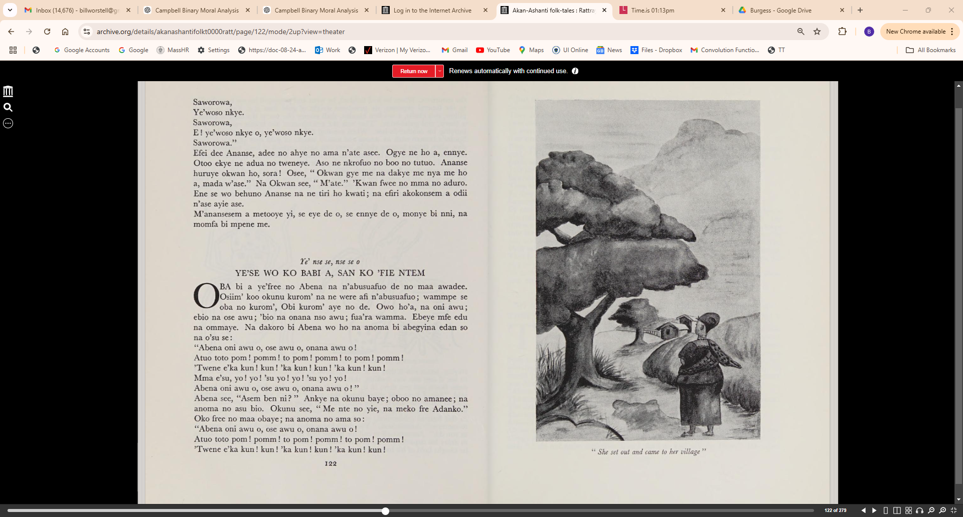

Slide 6
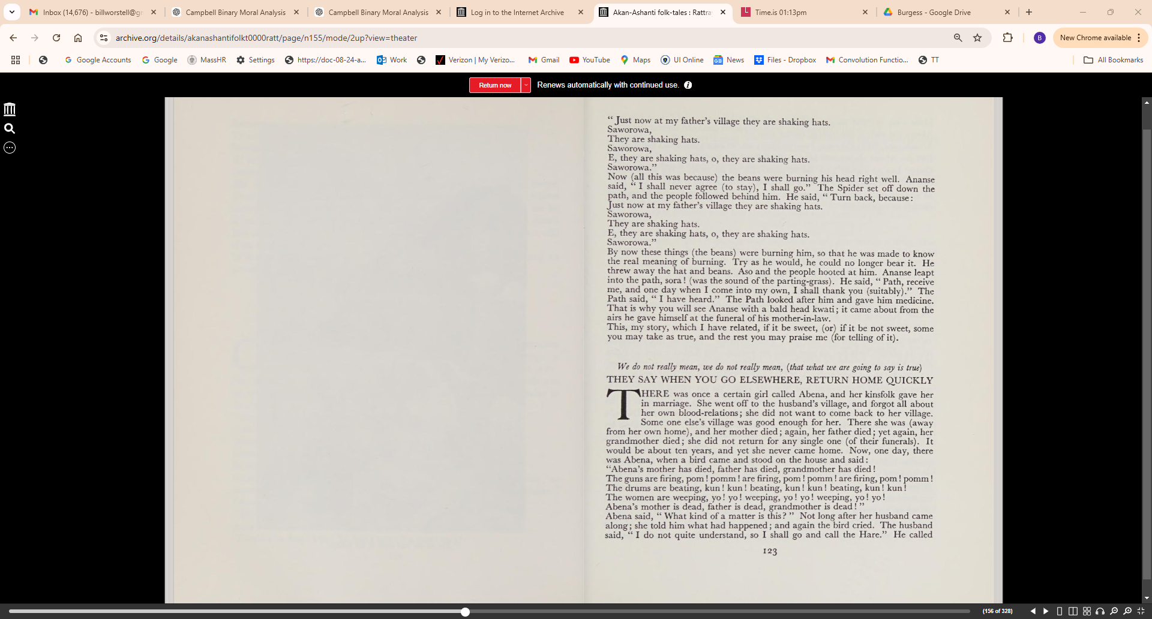

Slide 7
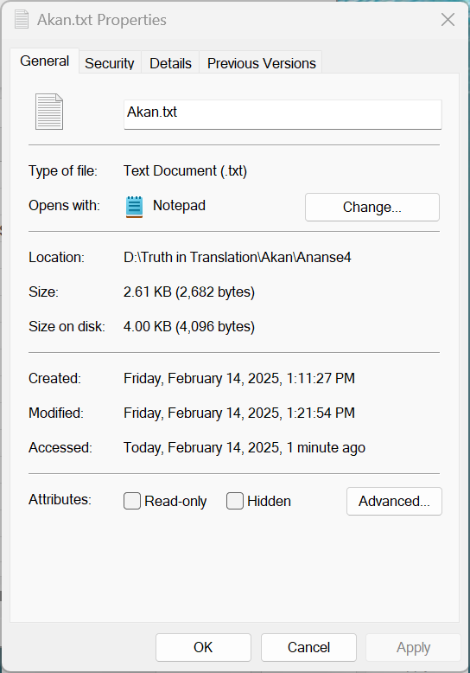
Ye' nse se, nse se o
SE YOYE A ANANSE OBEYE ATIPA
YE'SE Kwaku Ananse ne ne ye' Aso na ye'wo ho. Dakoro bi y'ako afuom' aha ; ankye na obofuo bi aha. Ananse bisaa amanee. Osee, "Nye biribi na w'ase na nnora odaye wansore." Ananse see, "Aso,
osempa." Aso de ne nsa guu ne ti, osuye. pue ! pue ! Ananse gyaa no kwan maa no koreye. Adeekyeye, Ananse ko seree Odwan, Okra, Okraman, Akoko ne Aberekyie se, "Dee m'ahuno ni, nti me sere mo, momma yenko gya me m'ase ayie." Nkrofuo no nnyina pene so. Ananse baa ne 'fie bepam korobonkye hyee kuntunkuni ntama. Yaoada soye, oko frefree nkrofuo a wasere yen na yen nnyina siim'. Ye' de atwene, atuo, ne nsa. Ananse duruu n'ase kurom' kurotia; atuo no watoto porn! porn! Ye' de agoro no koo 'fie ko tenaa ayie ase. Ode nsa ko maa 'yifuo. Owieye, oko boo nsa' peredwan asia, agopikyi, ntama mmienu, homo, sakyekyere, odwan ne nsa. Dee Ananse de siec n'ase eno, no. Onwuno, dwoye, ye'be tuu Ananse to asuanu
ne nsano. Adeekyeye, nnipa nnyina didiye, na yebe ka kyeree Ananse se
onnidi. Osee, " Me, Kwaku, m'ase awu; me'nnidi nnawotwe da. Me'nnidi,
na mo mpe biribi mma me nnamfonom a me ne yen baye nni na yenko."
Na Aso ko pee biribi beree mmarima no diye. Na yen dee ye'koreye; na
ekaa Ananse. Ananse wo ho'a, efei dee edii nnanan, na ogye ne ho a, ennye.
'Ofie so a otem', na adua a y'anoa esi 'gya so. Ananse fwe nen, fwe nen,
na otuu korobonkye no, tetee adua no bi de guum', na ode sii bio. Efei na
Aso baye. Osee, "Aso, m'akae seisei, Agya kurom' afahye a ye'woso nkye
no aduru, nti meko seisei." Aso see, " 0, na yei dee eyee den na wo nka
nkyeree me; efei so wo baa ayie, wo nnidiye da; na me sere wo okyena
w'ako." Ananse see, "Wo nnim dee aba nti na wo'ka yei." Aso koye ko free nkrofuo se ye'mmera mmeka bi nkyere Ananse na onyae koro. Nkrofuo
no baye. Ananse hunoo yen ara na waso 'kye nom' se: " Sese Agya kurom' ye'woso nkye.
Saworowa, Ye'woso nkye. Saworowa,
E! ye'woso nkye o, ye'woso nkye. Saworowa."
Na adua no e'hye ne tiri ase yie. Ananse see," Me'ntie_da, meko." Ananse sii 'kwan so na nkrofuo no dii n'akyi. Osee, " Mo nsan na:
Sese Agya kurom' ye'woso nkye.
Saworowa,
Ye'woso nkye.
Saworowa,
E! ye'woso nkye o, ye'woso nkye.
Saworowa."
Efei dee Ananse, adee no ahye no ama n'ate asee. Ogye ne ho a, ennye.
Otoo ekye ne adua no tweneye. Aso ne nkrofuo no boo no tutuo. Ananse
huruye okwan ho, sora! Osee, " Okwan gye me na dakye me nya me ho
a, mada w'ase." Na Okwan see, "M'ate." 'Kwan fwee no mma no aduro.
Ene se wo behuno Ananse na ne tiri ho kwati; na efiri akokonsem a odii
n'ase ayie ase.
M'anansesem a metooye yi, se eye de o, se ennye de o, monye bi nni, na
momfa bi mpene me.

Slide 8
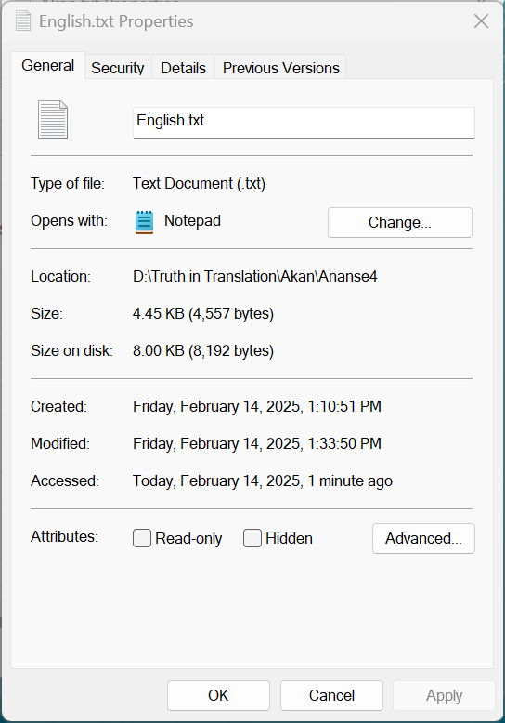
We do not really mean, we do not really mean (that what we are going to say is true)
HOW THE SPIDER GOT A BALD HEAD
THEY say that Kwaku Ananse, the Spider, and his wife Aso were once
living there. One day, they had gone and returned from the plantation;
soon after, a messenger came. Ananse asked him his business. He said,
" The only news is that your mother-in-law lay down yesterday and has
not risen up." Ananse said, "Aso, this matter is your affair." Aso placed her
hands upon her head and wept, pue! pue! Ananse gave her permission (to go
to the funeral). Next day, when things became visible, Ananse went and begged
Odwan, the Sheep, Okra, the Cat, Okraman, the Dog, Akoko, the Fowl, and
Aberekyie, the Goat, saying, " This is what I have seen, I beseech you therefore
to accompany me to my mother-in-law's funeral." All these people agreed.
Ananse (then) came to his house, and sewed a hat of leopard's skin, and dyed
his cloth a russet-brown colour. When Thursday arrived, he went and called all
the people whom he had begged (to accompany him), and all set out. They took
drums and guns and palm-wine. Ananse came to the outskirts of his mother-in
law's village; the guns were firing pom! pom! They took the dance-party and
went to sit down at the house where the wake was being held. He gave wine to the mourners. When he had finished, he went and presented his nsa contribution
to the funeral expenses, six peredwan weight of gold dust (i. e. £48), a velvet
pillow, two cloths, a woollen blanket, shell money (for use in the land of ghosts),
a sheep, and palm-wine. That was the contribution the Spider made towards
burying his mother-in-law. When evening fell cool, they came and raised the
Spider's bottom with an asuanu and nsano's weight of gold dust ('C4 I3S.). Next
day, when things became visible, every one again partook of food, and they came
and told the Spider that he might eat. He replied, " I, Kwaku, my mother-in-law
has died; I do not eat on the eighth day of a funeral ceremony. I shall not eat,
but get something for my friends, with whom I came, to eat, and let them go."
So Aso went off to search for something to bring these men to eat. So they went
off, and Ananse was left. There the Spider was, and now the fourth day came,
and try as he would, he could bear it no longer. Now, in the house where he was
staying, beans which they were boiling, stood on the fire. Ananse looked all round
to see if any one was looking, then he took off his leopard-skin hat, picked out
some beans and put them in it, and put it on again. Just then Aso came in. He
said, "Aso, I have just remembered that at my father's village, the hat-shaking
festival has come (and is being held), so I am going off at once." Aso said, " Oh,
what is the reason you did not tell me all this before, moreover, since you came
to this funeral celebration, you have not eaten at all; so I implore you to go
to-morrow." Ananse said, "You don't know what has come, that's why you talk
as you do."
Aso went off to call the people that they might come and tell Ananse
to delay his departure. The people came. No sooner did Ananse see them, than
he caught hold of his hat (and began to sing):"Just now at my father's village they are shaking hats.
Saworowa,
They are shaking hats.
Saworowa,
E, they are shaking hats, o, they are shaking hats.
Saworowa."
Now (all this was because) the beans were burning his head right well. Ananse
said, "I shall never agree (to stay), I shall go." The Spider set off down the
path, and the people followed behind him. He said, "Turn back, because:
Just now at my father's village they are shaking hats.
Saworowa,
They are shaking hats.
E, they are shaking hats, o, they are shaking hats.
Saworowa."
By now these things (the beans) were burning him, so that he was made to know
the real meaning of burning. Try as he would, he could no longer bear it. He
threw away the hat and beans. Aso and the people hooted at him. Ananse leapt
into the path, sora! (was the sound of the parting-grass). He said, "Path, receive
me, and one day when I come into my own, I shall thank you (suitably)." The
Path said, " I have heard." The Path looked after him and gave him medicine.
That is why you will see Ananse with a bald head kwati; it came about from the
airs he gave himself at the funeral of his mother-in-law.
This, my story, which I have related, if it be sweet, (or) if it be not sweet, some
you may take as true, and the rest you may praise me (for telling of it).

